Slide 1

Secure Password Pattern Validator using Brute Force String Matching
Department of Computer Science and Engineering
CSA0613 Design and Analysis of Algorithms
Submitted By:
B.SAI KRISHNA(192472300)
A.SHIVA SHANKAR REDDY(192425174)
V.SHIVA(192472256)
Guided by:
Dr. F. Mary Harin Fernandez

Slide 2


AGENDA
Abstract
Introduction
Objectives
Problem Identification and Analysis Solution
Architecture Diagram
Module 1,2,3
Output
Conclusion
References

Slide 3
Abstract
Password security is essential for protecting user accounts and sensitive information in today's digital world.
Weak and predictable passwords increase the risk of unauthorized access, brute-force attacks, and data breaches.
This project proposes a Secure Password Pattern Validator that uses the Brute Force String Matching algorithm to detect weak password patterns.
The system compares the user's password character-by-character with a database of common passwords and insecure patterns.
It identifies weak passwords containing repeated characters, sequential patterns (such as "123456" or "abcdef"), and commonly used passwords..

Slide 4


Introduction
Passwords are the first line of defense for protecting user accounts and sensitive information.
With the rapid growth of online services, the risk of cyberattacks and unauthorized access has increased significantly.
Many users create weak passwords such as "123456", "password", "abcdef", or repeated character patterns, making accounts vulnerable to attacks.
Weak passwords can be easily guessed using brute-force attacks or dictionary attacks.
A secure password should be difficult to predict and should follow standard security guidelines.

Slide 5
Problem Identification and Analysis
Weak and predictable passwords increase the risk of unauthorized access and cyberattacks.
Many existing systems fail to detect common password patterns, repeated characters, and sequential strings.
Simple passwords are highly vulnerable to brute-force and dictionary attacks.
There is a need for an efficient password validation system that identifies weak password patterns before acceptance.
Users require instant feedback and security recommendations to create stronger and more secure passwords.

Slide 6
Objectives
To validate password strength by checking whether the password meets standard security requirements such as length, uppercase letters, lowercase letters, numbers, and special characters.
To detect weak password patterns by comparing the entered password with commonly used passwords, repeated characters, and sequential patterns using the Brute Force String Matching algorithm.
To provide instant feedback by classifying passwords as Weak, Medium, or Strong and displaying suggestions for creating stronger passwords..
To demonstrate the application of Brute Force String Matching in password validation and promote cybersecurity awareness through a simple and effective security solution.

Slide 7
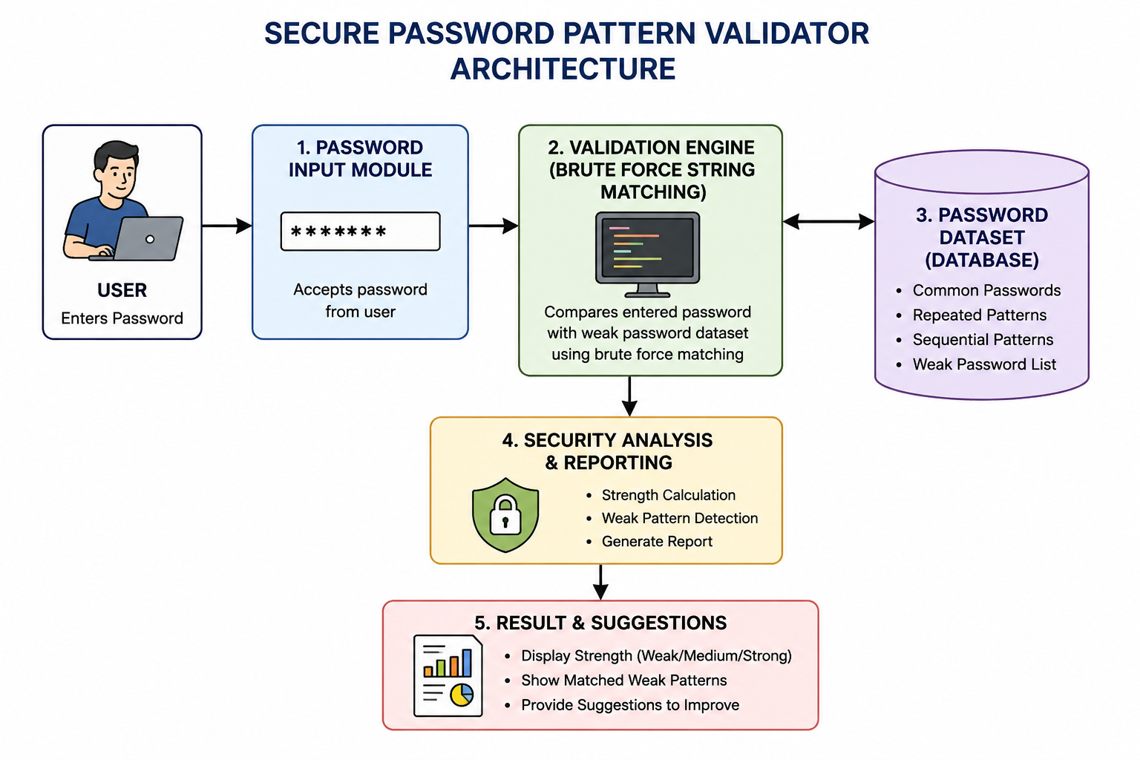
ARCHITECTURE DIAGRAM

Slide 8
Module-1: Password Dataset Management
Store Weak Passwords: Maintains a database of common and weak passwords such as "123456", "password", and "qwerty".
Organize Password Patterns: Stores repeated characters, sequential patterns, and common password combinations in a structured format.
Update Dataset: Allows adding, modifying, and removing password entries to keep the database up to date.
Support Validation: Provides the stored password patterns to the Brute Force String Matching module for comparison.

Slide 9
Module-2 : Password Pattern Validation Engine
Accept User Password: Receives the password entered by the user for validation.
Check Security Rules: Verifies the password based on length, uppercase letters, lowercase letters, numbers, and special characters.
Detect Weak Patterns: Identifies repeated characters, sequential strings, and common password patterns.
Validate Using Brute Force Matching: Compares the entered password with the stored weak password dataset using the Brute Force String Matching algorithm.
Generate Validation Result: Classifies the password as Weak, Medium, or Strong and sends the result to the feedback module.

Slide 10
Module-3 Security Analysis & Reporting
Analyze Password Strength: Evaluates the validated password and classifies it as Weak, Medium, or Strong.
Generate Security Report: Creates a report showing the password strength and detected security issues.
Provide Improvement Suggestions: Recommends adding uppercase letters, numbers, special characters, or increasing password length.
Display Validation Results: Shows the final password validation status and security score to the user.
Enhance User Awareness: Helps users understand password security and encourages the creation of strong, secure passwords.

Slide 11
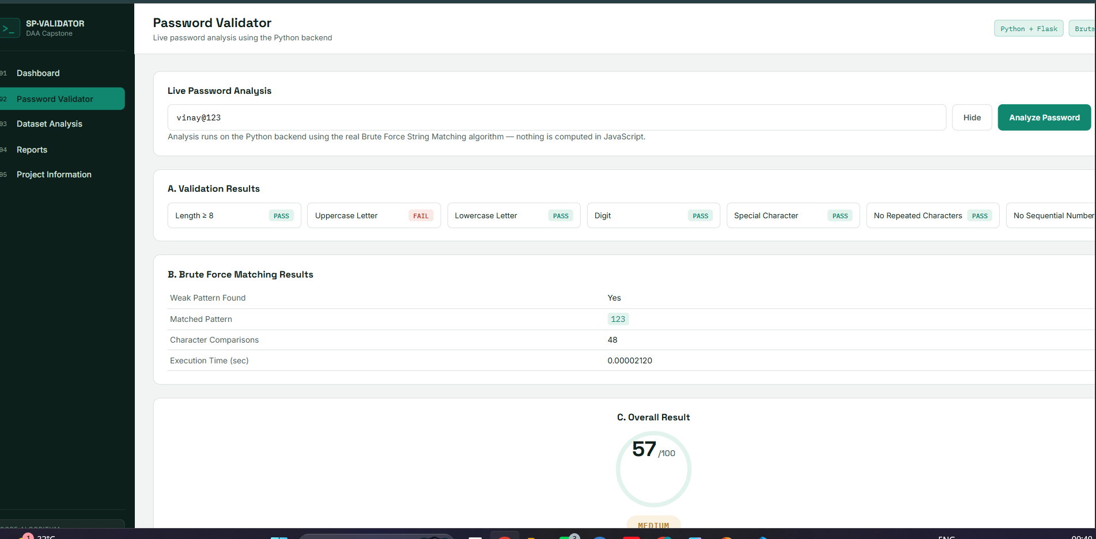
Output

Slide 12
CONCLUSION
The system effectively identifies weak and predictable password patterns using the Brute Force String Matching algorithm.
It validates passwords based on security rules such as length, uppercase, lowercase, numbers, and special characters.
The application classifies passwords as Weak, Medium, or Strong and provides suggestions for improvement.
The project enhances password security by encouraging users to create strong and unique passwords.
Overall, the system is simple, reliable, easy to implement, and suitable for educational, authentication, and small-scale security applications.

Slide 13
REFERENCES
Tiwari, D. et al. (2023). A systematic review of social network sentiment analysis with comparative study of ensemble-based techniques. Artificial Intelligence Review, 56, 13407–13461.
Rodríguez-Ibánez, M. et al. (2023). A review on sentiment analysis from social media platforms. Expert Systems with Applications, 223, 119862.
Singh, L. G. & Singh, S. R. (2024). Sentiment analysis of tweets using text and graph multi-views learning. Knowledge and Information Systems, 66, 2965–2985.
Mohammed, A. M. K. et al. (2025). GSAF: An ML-Based Sentiment Analytics Framework for Understanding Contemporary Public Sentiment and Trends. Information, 16(4), 271.
Lien, A. K. et al. (2022). OSN Dashboard Tool for Sentiment Analysis. arXiv:2206.06935.

Slide 14


